Slide 1

E-commerce Application
website for Amazon
using Appium
Chekuri Gayatri
192011305
CSA3731-SoftwareTesting
31st Jan,2023

Slide 2

Objective
E commerce testing helps in evaluating and accessing
the featuresand functionalities of an e commerce
application to make sure that it works as intended
with accurate operational functionality of the
e commerce application

Slide 3
amazon
Abstract
Amazon is the largest online retailer and technology provider.The Amazon.in Team is building the most trusted shopping experience in India.
The purpose of the project is to test the e-commerce website like Amazon.
The e-commerce business is increasing at a rapid pace especially since Covid. So it is very important to test e-commerce websites and applications such as Amazon.
We are rethinking eCommerce from an India-first perspective and are solving unique problems such as organizing India’s sellers and selection, regional discovery, mobile access across spotty networks and low end devices, highly reliable payments, ultra-fast delivery , advertising and more.

Slide 4
Proposed system
Automation of an application can be done using e-commerce testing tools such as Appium server and Appium inspector.
>>Testers can automate almost all functional tests using Appium.
Search for product(clothes,jewellery and shoes and cosmetics)
Sorting
Filtering
Product description page
wishlist
Shopping cart
Checkout
Order confirmation
Products Categories, Details and Search option Testing
Content Detail and Management Testing
Order Management Based Testing
Payments Testing
Analytics, Reviews & Ratings and User Profile Testing
JEFF BEZOS
Founder

Slide 5

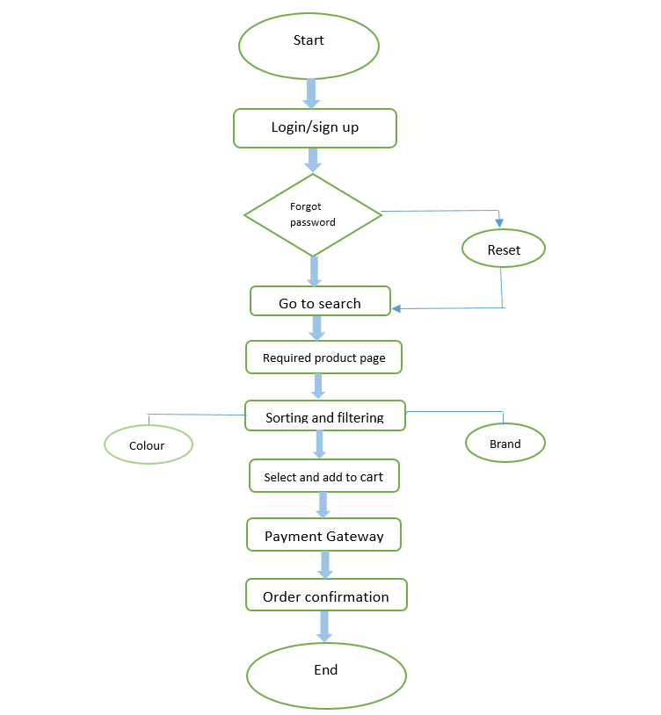
Flowchart
amazon

Slide 6
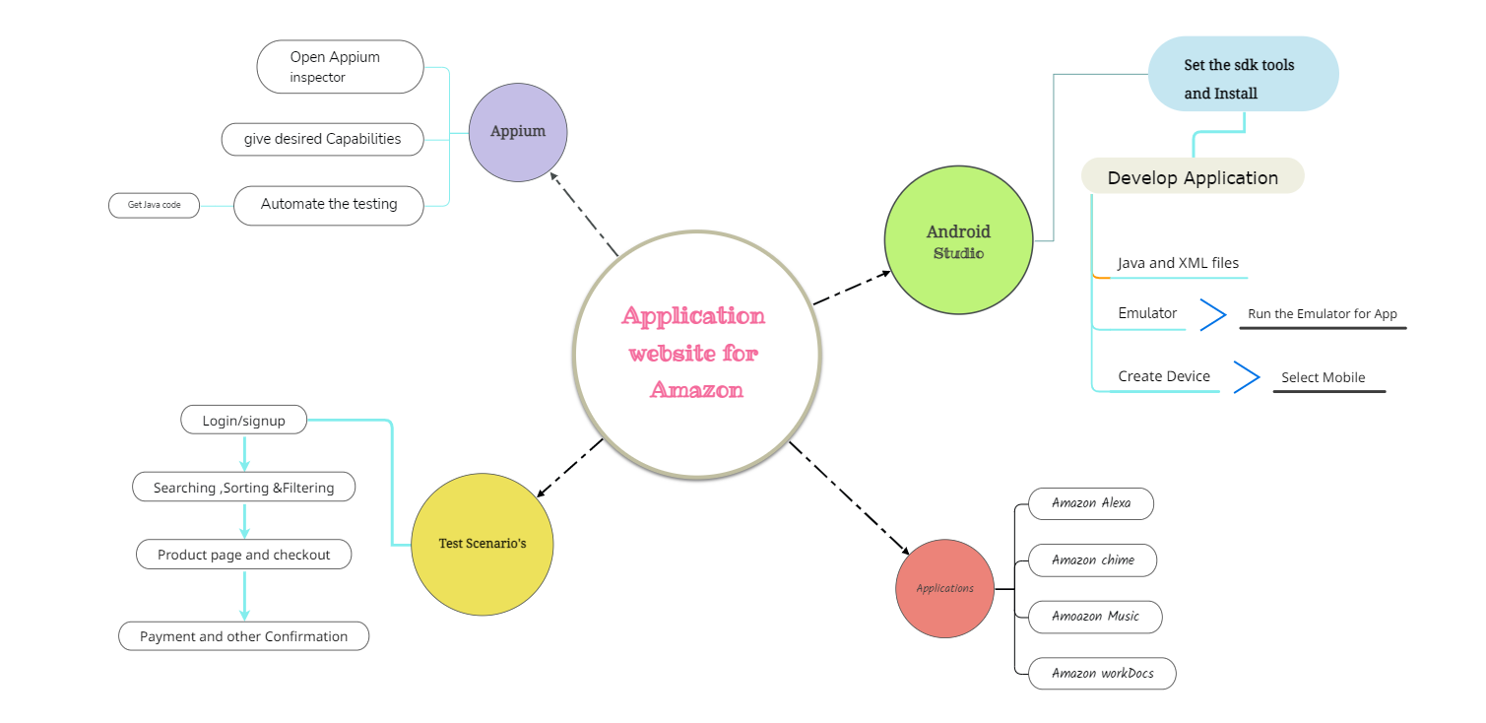
Concept Map

Slide 7
Test cases
Login/Signup
Search for product(clothes,jewellery and shoes and cosmetics)
Sorting
Filtering
Product description page
Wishlist
Shopping cart
Checkout
Payment gateway
Order confirmation

Slide 8



App Tools and Installation
Android Studio
Appium Inspector
Lamdatest

Slide 9
Installation
Download Android Studio
Install SDK in Android Studio
Download Emulator in Android Studio
Download Appium Inspector

Slide 10
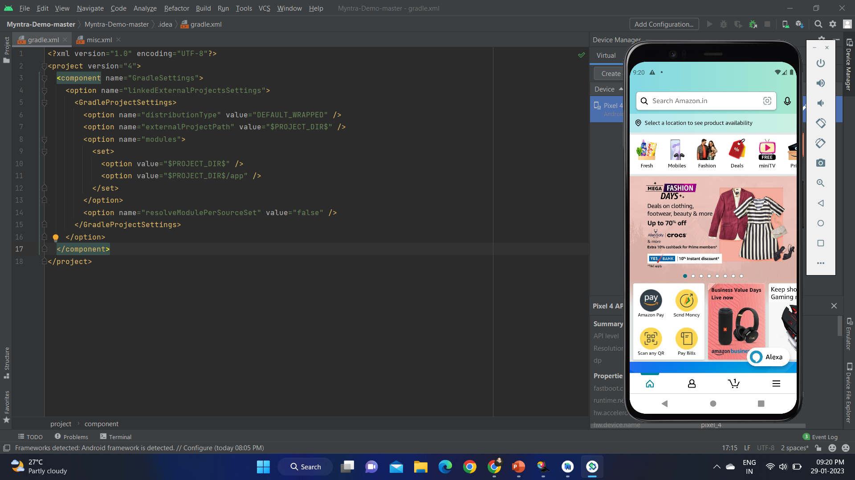
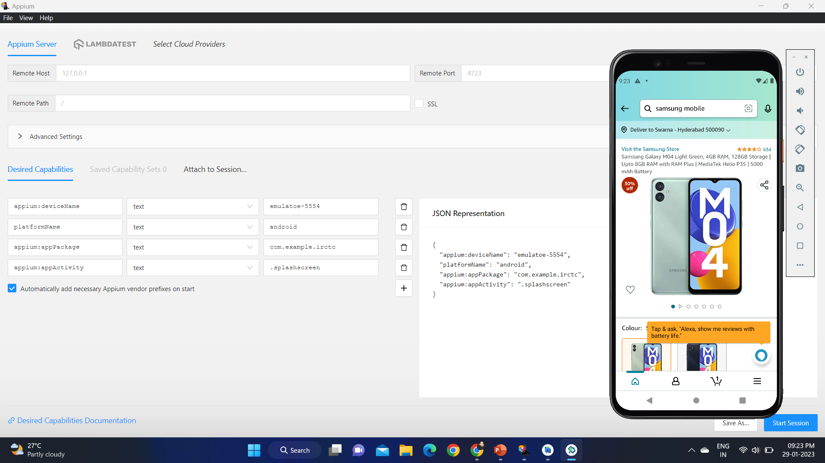
Implementation

Slide 11
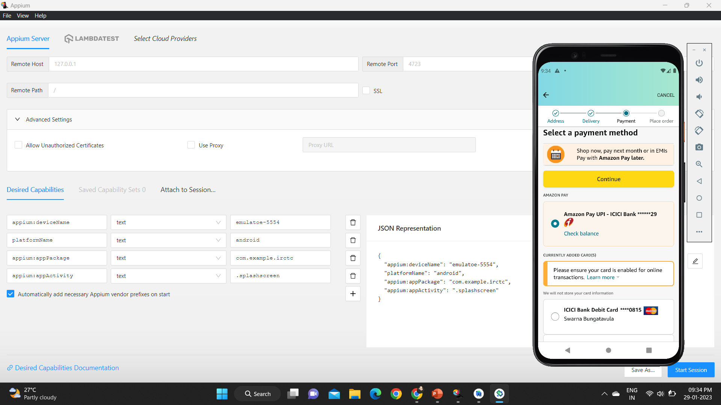
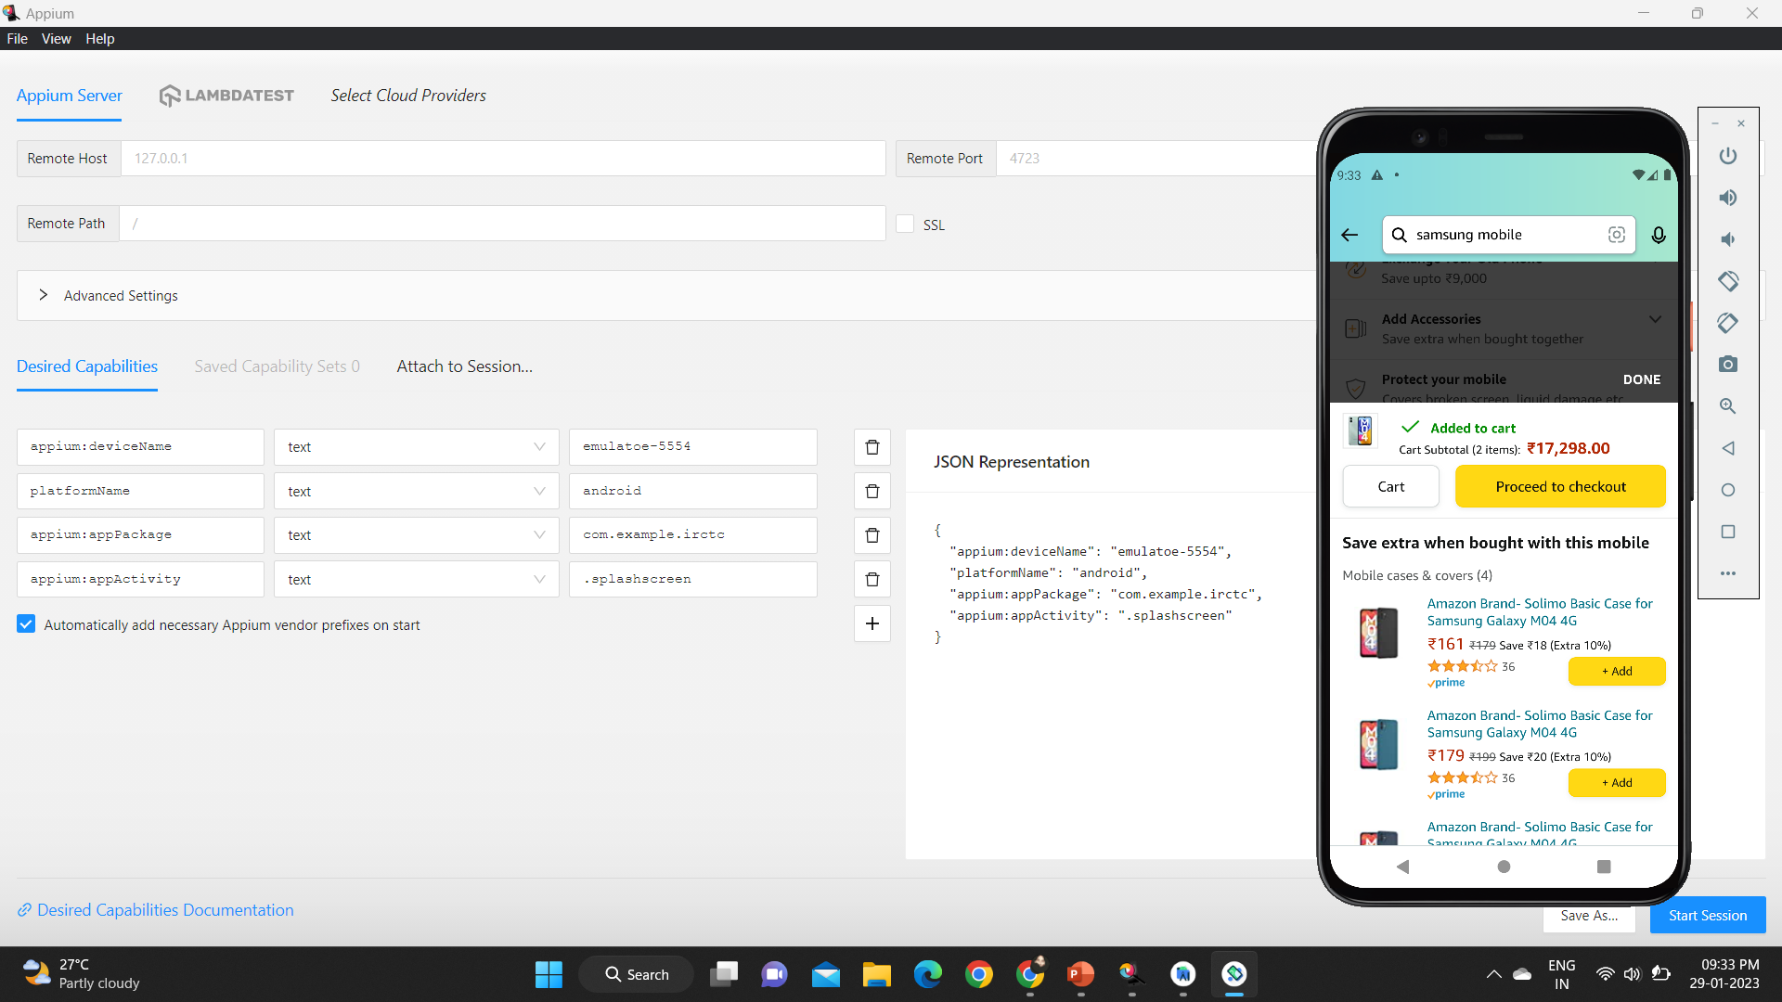

Slide 12
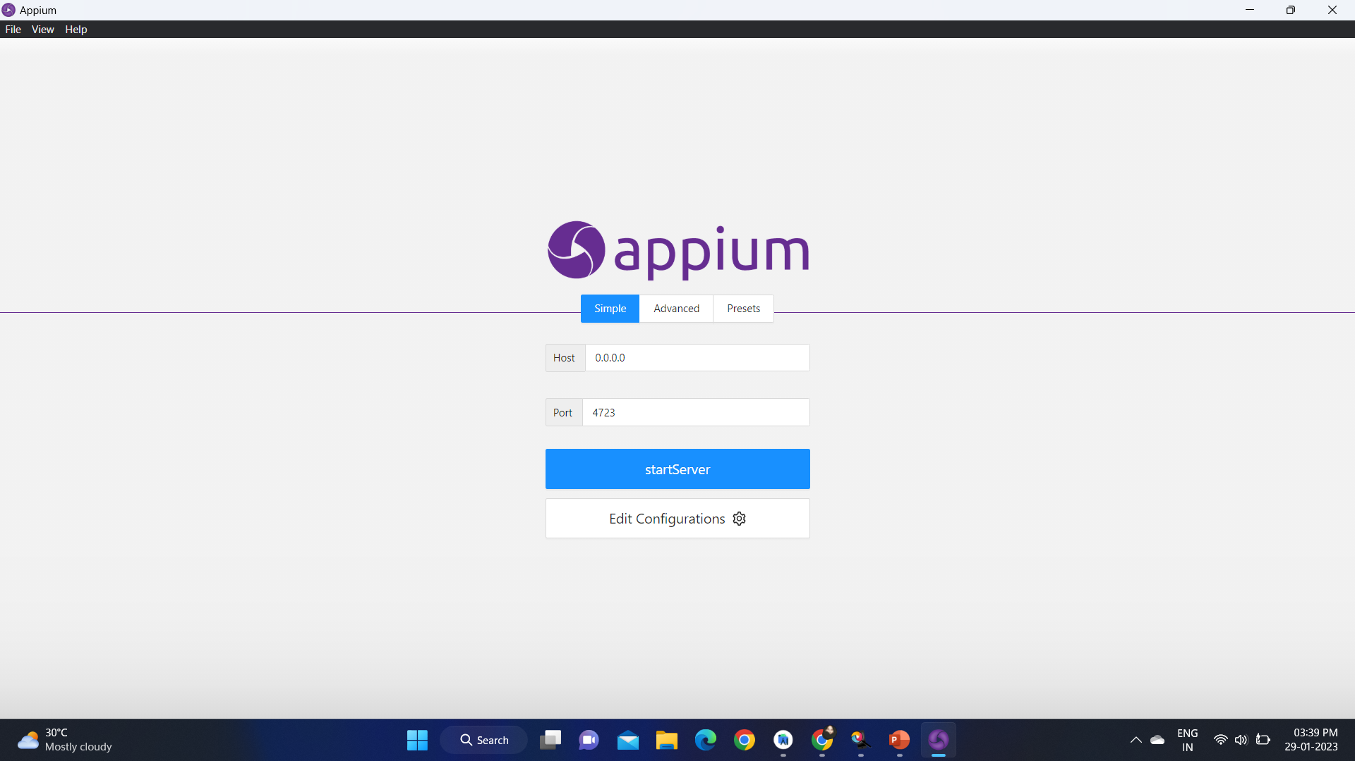
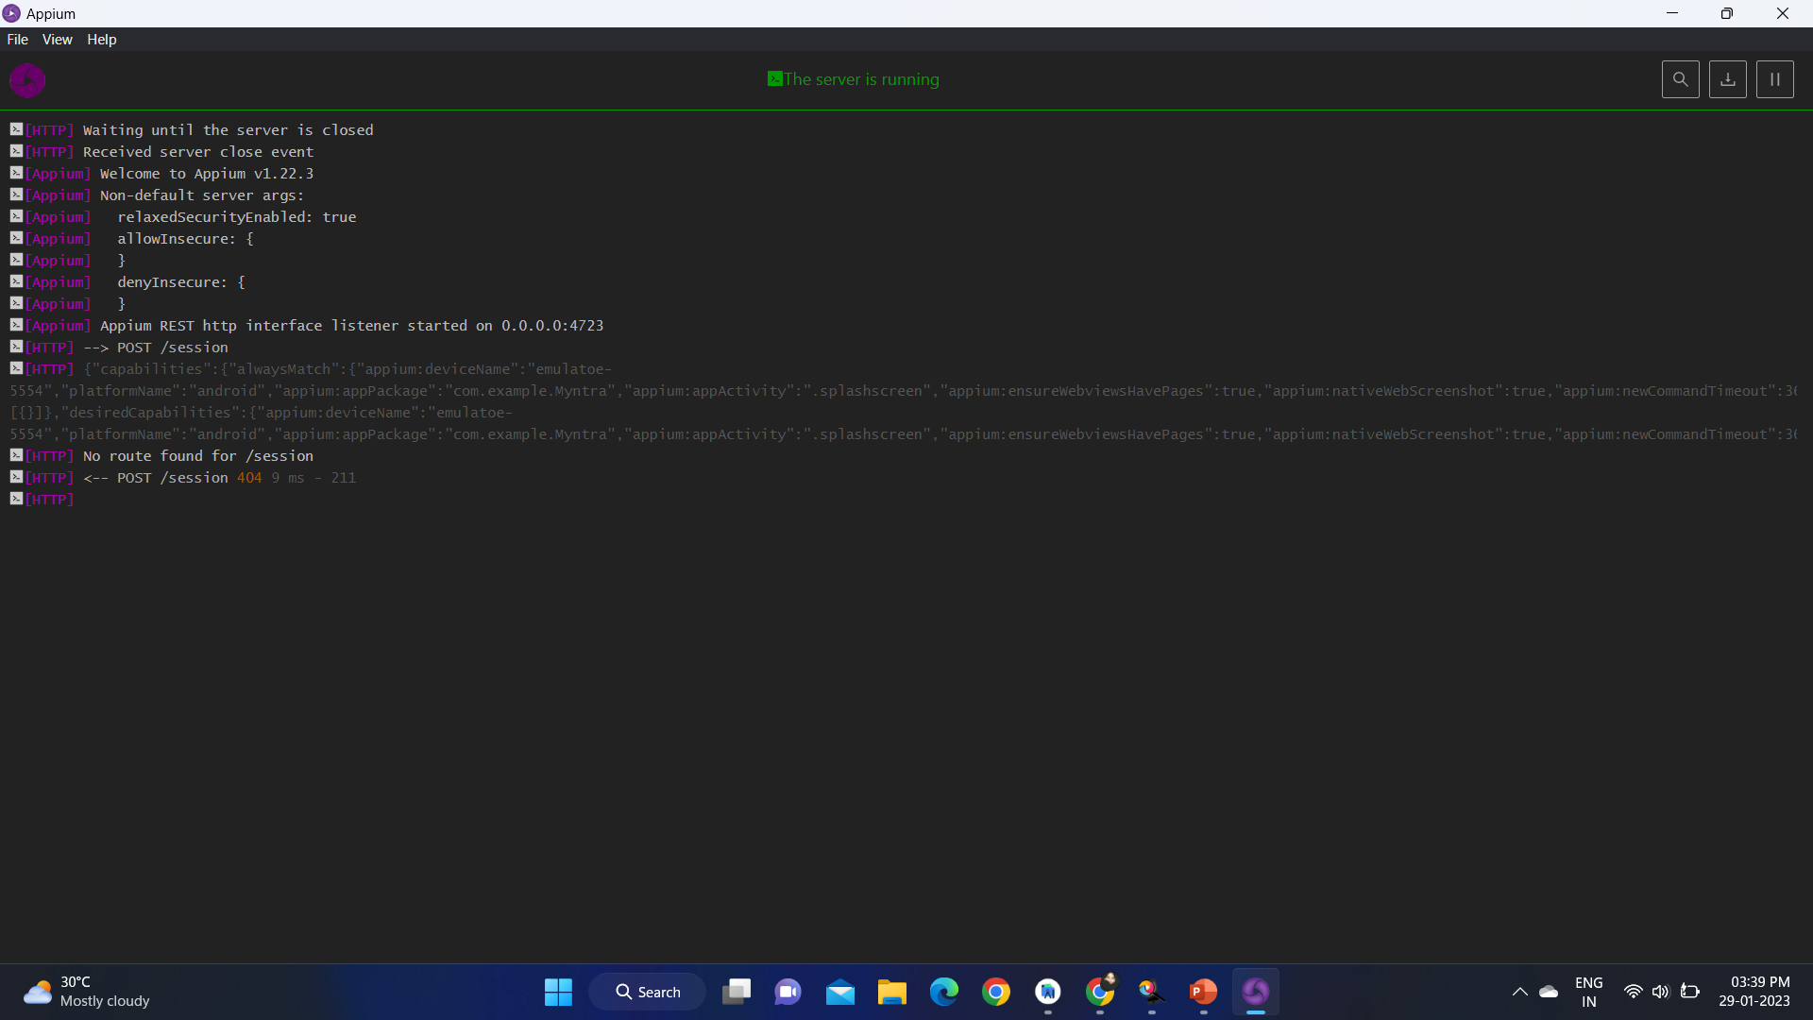

Slide 13
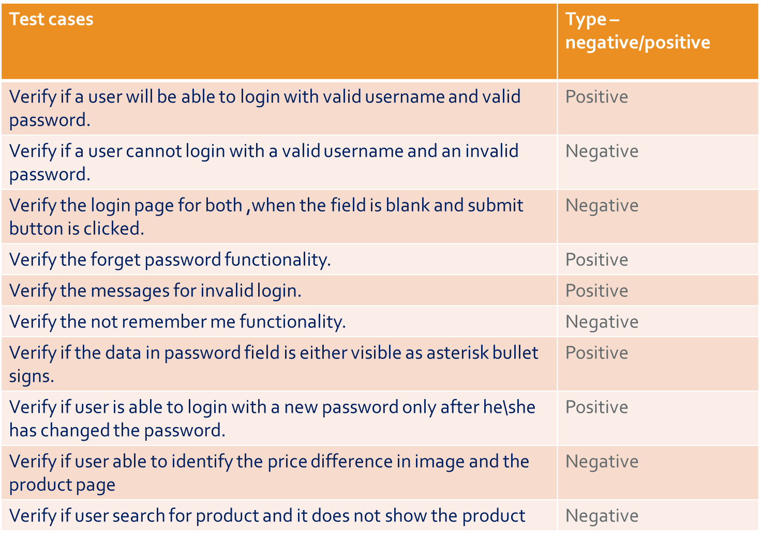
Testcase outcomes

Slide 14
Conclusion
The e-commerce application i.e Amazon has been developed using Android Studio.
And the testcases of this application have been tested successfully using Appium server and Appium inspection.
The testing of this website has the positive and negative testoutcomes to understand and improve the application functionalities effectively

Slide 15
thank you!

